Slide 1
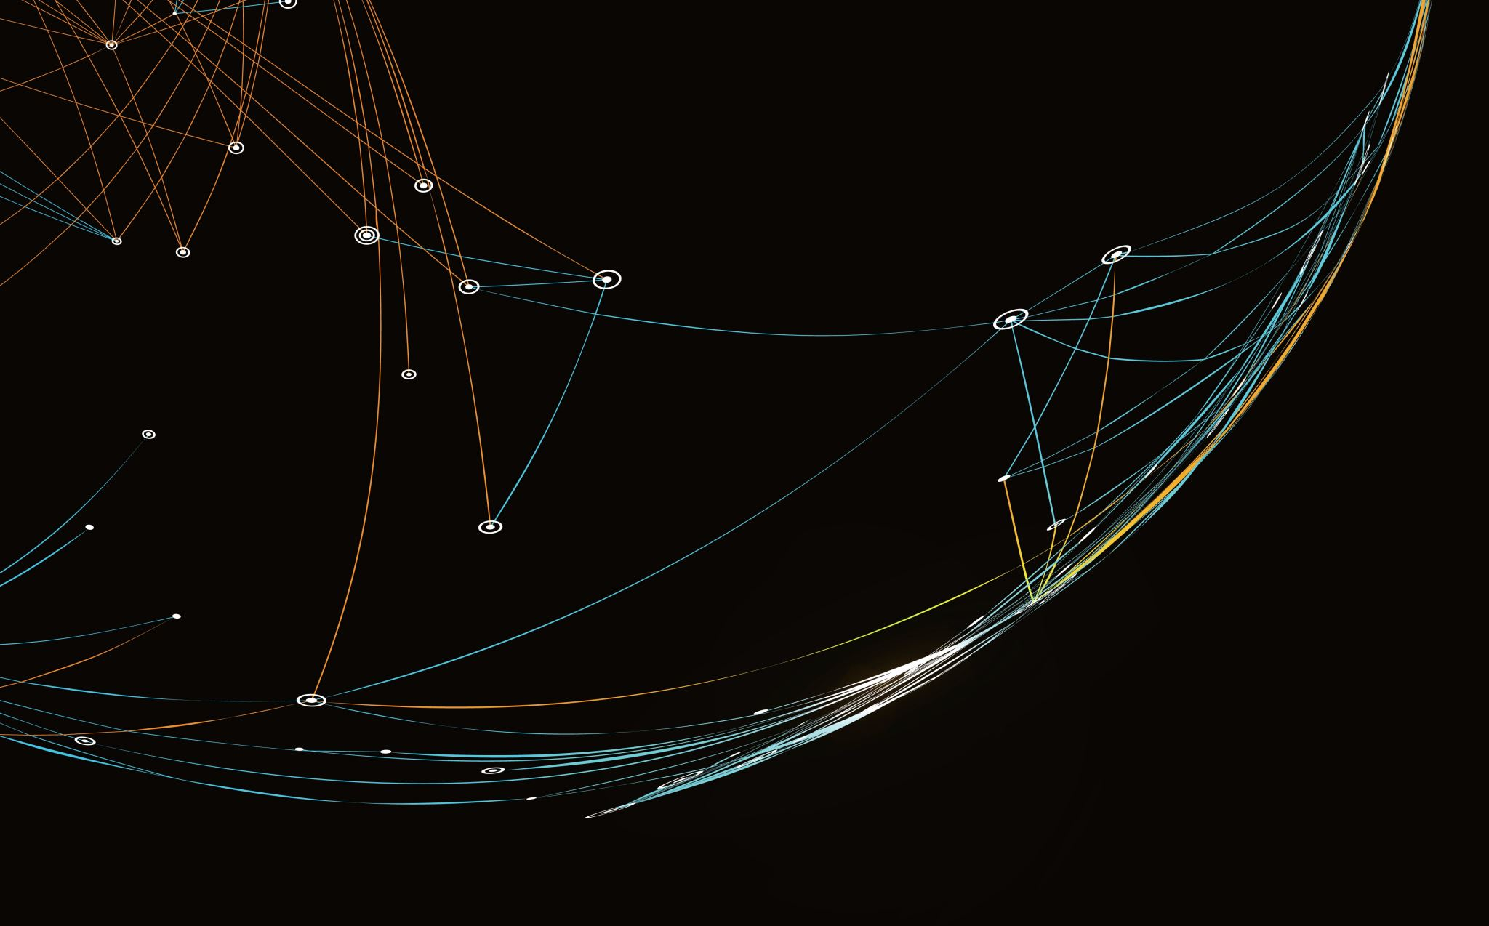
Sawt AlRu’ya
Empowering the Blind with Real-time Descriptions
Presented by: Ahmed Salem Ghaiath Abdoush Shatha Jadallah Nousheen Ali

Slide 2

Changing Lives, One Description at a Time
Our solution is more than just technology; it's a beacon of hope. By providing real-time audio descriptions, we're granting the visually impaired a renewed sense of independence, confidence, and joy. Every smile we witness is a testament to the positive impact we're making.

Slide 3
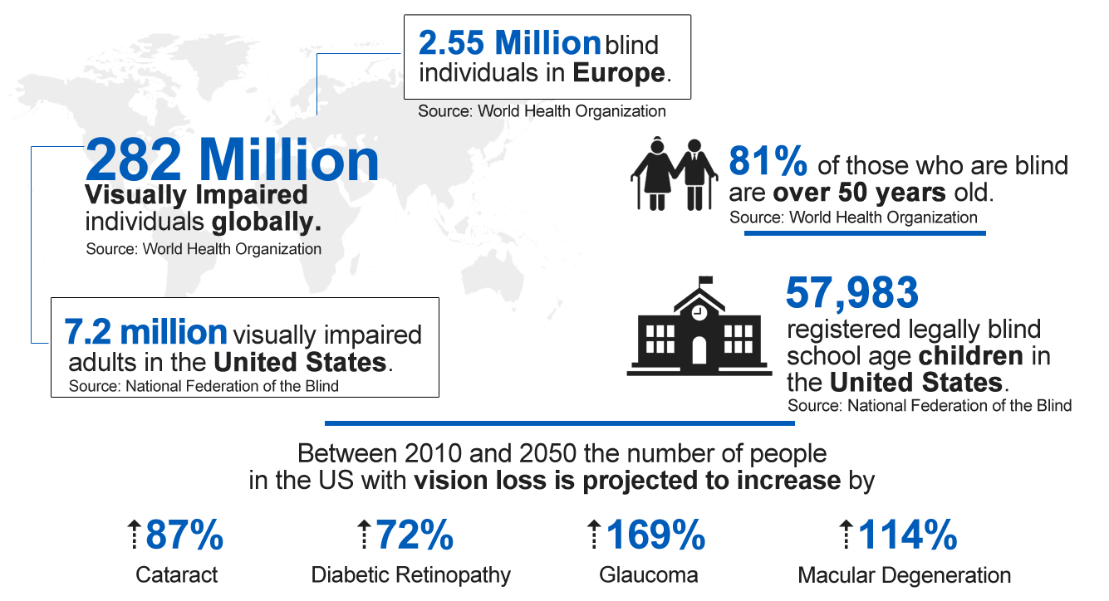

Slide 4

The Challenge of Visual Impairment
Mobility and Navigation
Reading and Writing
Employment
Social Interaction
Daily Activities
Notes:
Mobility and Navigation: Moving around safely, especially in unfamiliar environments, can be challenging. This includes crossing streets, avoiding obstacles, and finding specific locations.
Reading and Writing: Accessing printed materials, signing documents, and reading labels can be difficult.
Employment: Finding suitable employment opportunities and facing workplace discrimination are common challenges.
Social Interaction: Engaging in social activities and forming connections can be hindered due to misconceptions and stigmas associated with blindness.
Daily Activities: Simple tasks like cooking, shopping, and identifying money denominations can pose challenges.
Reference
Senjam, S. S. (2017). Impact of visual impairment on daily life activities. Indian Journal of Ophthalmology, 65(12), 1402. Link

Slide 5

Bridging the Visual Gap
Our innovative application harnesses the power of real-time video processing to provide audio descriptions for the visually impaired. By capturing their surroundings, the app translates visual data into meaningful auditory information.

Slide 6

Technical Overview
Data Input: Live stream video processed with OpenCV to convert into frames for instantaneous analysis.
Image Recognition: Utilize blip-image-captioning-base’s pre-trained models for efficient object detection from individual frames.
AI Description Generation: Engage GPT-3.5 Turbo API to transform detected objects into user-centric textual narratives.
Audio Conversion: Harness Google Text to Speech to audibly present AI-crafted descriptions to users.
Privacy Approach: Immediate data deletion post-processing ensures user privacy.
Preliminary Testing: Initial in-field tests conducted within our campus during the 24-hour hackathon period.

Slide 7
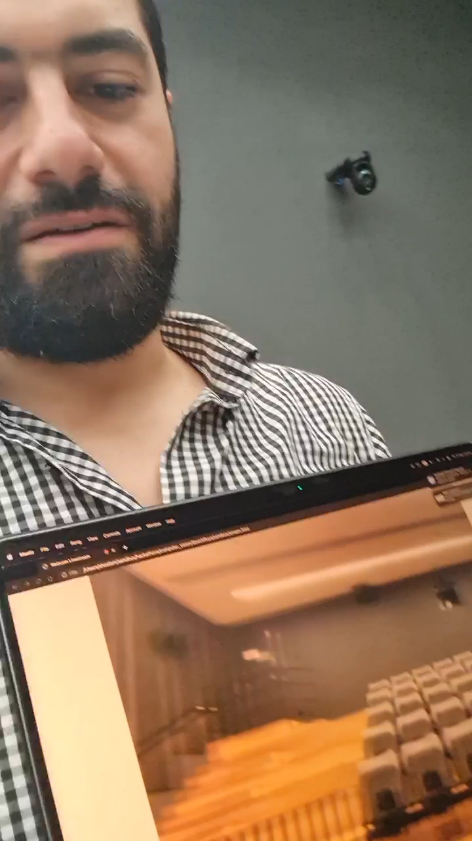
Seeing it in Action

Slide 8

Future Vision
Our journey has just begun. We envision refining our algorithms for even more precise descriptions, and enhancing the overall user experience:
Speech to text recognition
Act as AI virtual assistant
API Integration

Slide 9

Join Us in Making a Difference
We invite you to be a part of this transformative journey. With your support and feedback, we can make the world a more inclusive place for the visually impaired.

